Slide 1
Sports Officiating 101
OCEP Principles of Officiating Course
A Basic Course of Officiating Information
for Oregon High School Sports Officials

Slide 2
Topics
Introduction
Local Officials Association
Legal and Business Issues
Roles, Responsibilities, and Ethics
Goal Setting
Officiating Styles
Communication Skills
Building Confidence
Concentration and Anxiety
Making Decisions
Managing Conflict
Fitness for Officials
Looking Ahead

Slide 3
Introduction
Welcome

Slide 4

Participant Introductions
Who are you?
How much officiating experience do you have?
Why did you want to become an official?
  Prolong Athletic Involvement
  Personal Reasons
  Provide an Enjoyable Physical Activity
  Extra Money – Part-time Career

Slide 5
Local Officials Association
Lesson 1

Slide 6

OSAA Governing Structure
291 Member
High Schools
OSAA
Delegate Assembly
OSAA
Executive Board

Slide 7



OSAA Executive Director & Staff
OADA
OACA
OAOA
Local Officials Association

Slide 8
Your Local Officials Association
Join a local officials association:
www.osaa.org/officials
Governed by your association’s Executive Board as described in your association’s constitution and by-laws
Commissioner of Officials assigns games
  Don’t lobby or beg for games – do not trade assignments
  Do not solicit games from coaches or Athletic Directors (ADs)
Attend regular meetings

Slide 9
Your Local Officials Association
Most associations are incorporated as non-profit corporations for educational purposes
OAOA dues provide director’s and officer’s insurance coverage
Associations may charge membership dues or fees:
  Some association collect dues at the start of the season
  Others may automatically deduct dues and fees from payments

Slide 10
Utilizing Your Association
Communicate – especially with your Commissioner
Find a mentor or develop a support network
  Car-pool to assignments with crew
  Hang around officials, watch games, arrive early, stay later
  Post-game get-togethers
Training opportunities: camps, clinics, films, publications
Ask for observations; get feedback
Connect with national associations, NASO, frequent officiating websites

Slide 11
Questions to Ask
What is the process for advancement in your local officials association?
If you feel that you’re being treated unfairly, how do you voice your concerns and to whom?

Slide 12
Legal and Business Items
Lesson 2

Slide 13
OSAA Certification Requirements
To be an OSAA certified official, an individual must:
  Be at least 18 years of age
  Be a member in good standing of a local officials association
  Complete the annual OSAA online officials registration process
  Take the NFHS rules exam
  Attend six study/training meetings or complete 10 hours of training
  Pass an annual criminal history conviction screening
  Complete an annual OSAA concussion awareness training course
The full list of certification requirements can be found in the OSAA Athletic Officials Handbook, Rule 4

Slide 14
Criminal Conviction History Screening
Per OSAA rule to be certified, officials cannot have been convicted of:
  A felony involving the use, possession or sale of a controlled substance within the last 10 years*; or
  A crime involving the use or threatened use of violence against a person within the last 10 years*; or
  A crime involving a minor child at any time.
*The 10-year period of ineligibility to officiate shall commence from the date of suspension from officiating duties or from the date of conviction – whichever occurred first

Slide 15
Concussion Training Requirement
In the state of Oregon, the law requires youth sports officials to receive annual training on concussions
The OSAA requires an online course to be completed (which meets this requirement) before an official is allowed to be assigned to any contest
The OSAA online course, “Understanding Concussions – What Officials Need to Know”, is oriented towards officials and is the only acceptable training recognized for OSAA officials
Concussion training must be completed every year

Slide 16
OCEP Principles
The OSAA/OAOA Officials Certification and Education Program, or OCEP, is designed to ensure that Oregon officials statewide are trained in a consistent and standardized manner
There are two components: OCEP Principles certification and sport specific OCEP Playoff certification
Officials must obtain OCEP Principles certification within the first three years of officiating
This course presentation fulfills this requirement
Officials certified by the OSAA in 2005-06, or prior; or any transfer official from another state are exempt

Slide 17
OCEP Playoff
As part of OCEP, officials selected to officiate any OSAA State Championship event must have obtained and be currently certified in their sport specific OCEP Playoff certification
To obtain, officials shall attend an OCEP Playoff Certification Clinic, soccer officials obtain OCEP Playoff certification by completing the USSF Grade 8 Referee Course
To maintain, and have current OCEP Playoff certification:
  Football, Volleyball, Basketball, Baseball, and Softball officials must recertify every five years in the same manner as obtaining OCEP Playoff certification
  Wrestling officials must recertify every three years in the same manner as obtaining OCEP Playoff Certification
  Soccer officials must recertify every five years by attending one of the following: ORC Referee Committee Regional Referee/Intermediate Training Clinic, ORC Big Training Weekend, or an SRI approved training session

Slide 18
Levels of Certification
Level | OSAA Registration | Background Check | Concussion Training | Exam | OCEP Principles | OCEP Playoff
Registered | ✓ | ✓
 | Cannot officiate any OSAA sanctioned contest
Sub-Varsity | ✓ | ✓ | ✓ | < 75%
 | Can officiate OSAA sanctioned contests below the varsity level
Varsity | ✓ | ✓ | ✓ | ≥ 75%
 | Can officiate varsity and sub-varsity OSAA sanctioned contests
Playoff | ✓ | ✓ | ✓ | ≥ 90% | ✓ | ✓
 | Can officiate any level of OSAA sanctioned contest and OSAA State Championship events

Slide 19
Independent Contractors
OSAA officials are Independent Contractors, not employees
No withholding of state or federal taxes from earnings
  Independent contractors receive a Form 1099 at the end of the year
  Solely responsible for reporting and paying taxes, including state and federal income taxes, self-employment taxes, etc.
  Some officiating expenses can be deducted
  Consult a tax professional
Not subject to wage/hour laws (min. wage, overtime, rest periods)
Not covered by worker’s compensation insurance
Cannot use the wages they earn to qualify for unemployment insurance benefits when they are unemployed
No employment benefits, such as health insurance and pension plans

Slide 20
Important Liability Concerns
Incidents with player injuries
  Allow medical personnel to attend to the player
Game played according to the rules
  Manage the game, control rough play, penalize unsporting conduct
Player equipment
  What is allowed and what isn’t; do not compromise participant safety
Playing surface inspection
  Safety is the number one priority

Slide 21
Official’s Legal Concerns
Officials need to have good medical and personal liability insurance, or as required by state law
Secondary coverage is available through the NFHS
Additionally through the National Association of Sports Officials (NASO)

Slide 22
Other Administrative Items
The OSAA and the NFHS do not recognize protests
In the justice courts, game calls cannot be challenged or outcomes changed without demonstrable corruption (bribery)
Disagreement over calls is part of the game, it’s part of our human nature
Officials should support one another, even if opinions differ
Judgement calls can be readily defended by governing bodies and commissioners
However, the misapplication of rules is inexcusable

Slide 23
Physical Contact with Officials
Under Oregon law, it’s a criminal offense to assault a sports official
However rare, be prepared with recommended procedures:
  Don’t physically strike back – get to somewhere safe
  Identify the attacker, if possible – even if just a description
  Obtain names and contact information of witnesses
  Write down what happened and how you were injured
  Get appropriate medical attention, if necessary
  Determine if video of the game/incident is available
  Contact your Commissioner immediately
  Consult legal counsel

Slide 24
Roles, Responsibilities, & Ethics
Lesson 3

Slide 25
Roles
What are the roles of the official?
Keep the Game
Safe, Fair, and Fun

Slide 26
Responsibilities
Ensuring Player Safety
  Coach must assert players are legally and properly equipped
  Officials must inspect and enforce proper player equipment for rule compliance and for safety of all participants
Inspecting Facilities
  Plan to set aside time for field/court/facility safety
  Identify and correct safety hazards utilizing game-site administrators
  The earlier recognized, the better

Slide 27
Responsibilities
Regulating Game Conduct
  It is up to the official to know the rules of the game
  Enforcement of infractions/violations falls to the official
  Officials must learn when to use warnings, when to penalize, when to ignore, and when to be firm
  Player safety and unsportsmanlike behavior are important aspects that need to be addressed – what you allow, you promote
Injury Response
  When in doubt, act on the side of caution in regards to player safety

Slide 28
Responsibilities
Response to Crowd Situations
  If necessary, alert game management
  Do not engage with spectators directly
Encouragement of Fair Play
  Fundamental role of an official is to see the contest is played in a safe, fair, and fun manner
  Know the allowable considerations for rule enforcement
  Avoiding outside influences and ignoring irrelevant factors will help officials operate consistently throughout the entire contest

Slide 29
Responsibilities
Promotion of Good Sportsmanship
  Officials can influence player behavior through game management and rule enforcement
  There are many tools at the disposal of officials
  Acknowledge acts of good sportsmanship
  Penalize unsporting conduct

Slide 30
Ethics
Master Knowledge of Rules and Mechanics
  Officials shall master both the rules of the game and the mechanics necessary to enforce the rules and should exercise authority in an impartial, firm and controlled manner
  Officials need to know what they are doing when they step onto the field, court, or floor
  We need to know the rules and where to stand to make the best calls
  Officials must be decisive, and not inconsistent, and always in control of their emotions

Slide 31
Ethics
Work Constructively and Cooperatively
  Officials shall work with each other and their state associations in a constructive and cooperative manner
  Officials need to get along with and respect the people in their local association, their officiating partners, and the folks at the state office
  Everybody needs to work together to make things better
  There is no justification to “bad mouth” anybody
  Getting along makes your officiating experience more rewarding and enjoyable

Slide 32
Ethics
Uphold Honor and Dignity of the Profession
  Officiating is no longer a casual hobby, treat is as a profession
  Officials have a vast amount of “final” power and need to behave in a professional manner at all times
  Be a responsible and professional steward of the game
Prepare Mentally and Physically
  Dress neatly and carry yourselves in a manner consistent with the high standards of the profession
  Officiating is a physical activity, be in good shape
  Focus on the job at hand and leave other problems behind for a few hours
  Look good; the uniform and how it’s worn says a lot about your commitment

Slide 33
Ethics
Respect and Fulfill Contractual Obligations
  Communicate your availability and be mindful of your commitments
  Professionalism includes being accountable to your obligations
  It’s a cardinal sin to be late to a game; plan ahead
  Leave plenty of time for heavy traffic, travel, weather, etc.
  If you accept a game assignment, be there
  Contact your assigner or one of your partners if problems arise
  Don’t turn back one assignment for a better offer; this is unethical behavior that will not be tolerated

Slide 34
Ethics
Your Conduct Influences Respect of Others
  Remember you only get one chance at a first impression
  Your actions may be perceived as representative of your officials association or toward the profession itself
  Do not do anything that diminishes the respect people have for officials - don’t say or do anything unwise or compromising
  Do not draw attention to yourself, be professional, the game is not about you, it’s about the players
  Sometimes that’s hard for an official to accept, because it’s human nature to want to be recognized for the job you do

Slide 35
Conflict of Interest
Sports officials must be alert to potential conflicts of interest
In the perfect world, officials would be strangers to coaches and schools, but in the real world, that’s not going to happen
It’s the perception of bias and favoritism that makes things difficult when officials do not recognize potential conflicts of interest
Officials are ethically bound to report any conflict of interest, no matter how remote, to their assignor
Assignors appreciate knowing this in advance prior to making a schedule, but should a conflict of interest develop as the season progresses, officials must request a change in assignment

Slide 36
Minimum Conflict of Interest Policies
Unless the ADs and the assigning Commissioner agree, no official shall be assigned to a varsity contest if:
  The contest involves a school currently attended by the official’s child or step-child
  The contest involves a school at which the official or a member of his/her immediate family is a current employee or coach
  An immediate family member of the official is a team member of one of the involved teams
  The contest involves a school from which the official has graduated within the last four years
  There are other factors or relationships between the official and a participating school that, in the judgment of the commissioner or the official, might give rise to the appearance of a conflict of interest

Slide 37
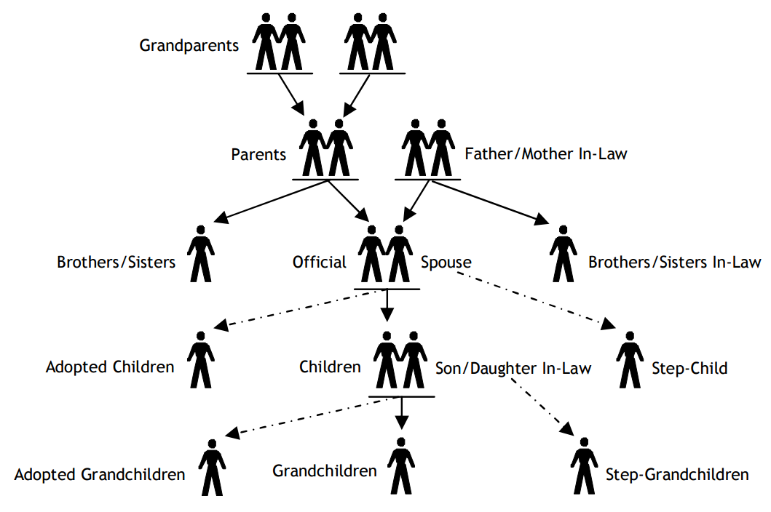
Immediate Family

Slide 38
Goal Setting
Lesson 4

Slide 39
Set Goals
In order to be successful at anything, you must have some goals
Setting goals helps to motivate and improve performance; if you set an important goal for yourself, you will generally work hard to achieve that goal
Without goals, many people just drift through life, some bump into success along the way, others don’t
Goals help focus on what is important
Setting goals is setting standards for what you’d like to do

Slide 40
Potential Problems with Setting Goals
Not measurable
Conflict with other goals
No ownership
Setting too many goals
Obstructed by fear of trying something new or fear of failure
Setting goals to please someone else; lacking investment
Unrealistic expectations

Slide 41
Goal Setting Suggestions
Consider your needs as the highest priority
Identify what you want to get out of officiating
  What are your strengths?
  Do you want to further improve?
  What are your weaknesses?
  What do you want to change?
  What do you enjoy the most out of officiating?
  How can you advance?
  Are there previous evaluations or feedback to reflect on?

Slide 42
Setting Successful Goals
Establish short term and long team goals
Make goals specific
State goals in positive terms
Set goals that are obtainable
Set goals that are measurable
Have a feedback mechanism in place
Know what is necessary to achieve your goal
Be flexible and change or adapt as necessary, learn from speedbumps
Enjoy meeting your goals

Slide 43
My Goals
Take a minute or two and identify one goal you can accomplish this season.

Slide 44
Officiating Styles
Lesson 5

Slide 45
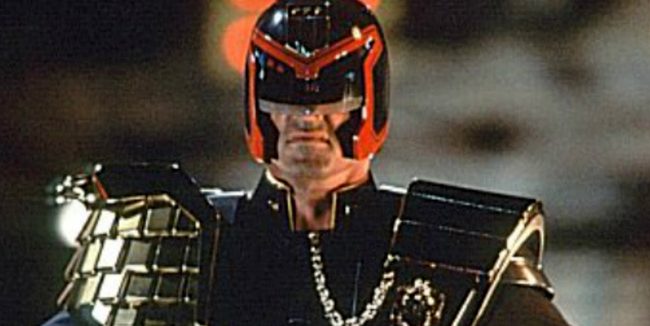
By the Book Approach – I Am the Law
Master of the rules, inside and out
Events are very black and white with prescribed reactions
Pros?
Cons?

Slide 46

Little Involvement – Less is More
Let players play with as little interference as possible
Avoid conflict, let game flow
Pros?
Cons?

Slide 47
The Middle Ground
Use common sense
Implement preventive officiating and know what that means
Be well versed in the rules of the game, but also know the spirit of the game and the correct intent of the rules
Know what to call and when to call it
Know when the best call may be a “no-call”

Slide 48
Context of a Contest
The context of a game may determine which officiating style works best
  Big cross town rivalry
  Bad blood between opponents
  Skill level of the players
Some of these may be known before the game starts
Be mindful of your preconceptions coming into a contest, do not let your personal preferences or notions impose itself on a contest unduly

Slide 49
Good Officials
Know the rules and spirit of the game
Know and use correct vocabulary
Know mechanics for positioning and signaling
Communicate effectively
Make calls with confidence
Are able to focus on the game
Remain invisible – don’t draw attention
Keep in control – stay poised
Stay in shape and hustle

Slide 50
Traits of Top Officials
Average Officials
Top Officials
Reactive
Foul Management
Calls Fouls
Sees Advantage
Avoids Pressure
Penalizes
Proactive
Game Management
Sorts Fouls
Feels / Anticipate
Handles Pressure
Communicates

Slide 51
Here’s What It Takes
Be a good partner
Have passion
Be consistent
Develop a rapport with participants; be approachable
Be decisive; firm and fair; unflappable
Maintain integrity
Use good judgment
Enjoy what you are doing

Slide 52
Admirable Characteristics
Think of a past role model, could be an officiating colleague, a teacher, a mentor, a friend
What is one single aspect that makes him or her stand out?
What character trait did you think was their strength?
How can you integrate that characteristic into your officiating style?
Reflect on your strengths.

Slide 53
Communication Skills
Lesson 6

Slide 54
Referee Tools
What tools are at your disposal as an official when it comes to managing a contest?

Slide 55
Referee Toolbox
Body Language
Terminate
Warn
Hand Gestures
Caution
Suspend
“The Look”
Whistle
Ejection
Admonish
Smile
Voice

Slide 56
Effective Communication
Two important steps:
  Sending the right message
  Being a good listener
When speaking, be clear and concise; go slowly
Choose your words and if you can’t think of something to say, don’t say anything at all
Silence is often misinterpreted, but never misquoted
There are many ways officials communicate

Slide 57
Body Language
Physical appearance
Posture and body position
Signal mechanics
Hand gestures
Facial expressions and eye contact
Personal space
Tone, pitch, and inflection

Slide 58
Communicating with Partners
Must function effectively as a team
Make an effort to get along with others
Take responsibility for your own actions
Don’t blame others for your mistakes
Encourage each other – be honest
Share strengths and experiences
Ask for help or advice – give when asked
Assist, do not insist

Slide 59
Keys to Success
Have a good pre-game conference
Have a good post-game conference
Ask for feedback from partners, game observers, evaluators
Examine your own performance; self-evaluation
  What did I do well?
  What can I do better?
Be aware of some potential barriers
  Crew members of the opposite gender
  Variance of officiating experience
  Language barriers

Slide 60
Building Confidence
Lesson 7

Slide 61
What Is Confidence?
Confidence is the belief that you can successfully do what you want to do
The feeling or belief that one can rely on someone; firm trust
A feeling of self-assurance arising from one’s appreciation of one’s own abilities or qualities

Slide 62
Importance of Confidence
Confidence is a skill that can be learned
You have to think that you are able to successfully do what you want to do
You have to believe that you will make the correct call
You have to get rid of negative thoughts
Talk to yourself in a positive manner
Don’t let your confidence be shaken by criticism dished out by coaches, players, spectators, or even yourself
That’s a tough one!!! If it were easy, everyone would officiate

Slide 63
Building Confidence
Practice your skills and techniques
Work lower level games
Attend camps and clinics
Get as much experience as you can
Observe and ask questions of others
During the contest, get the easy stuff right

Slide 64
Overconfidence
Officials who are overconfident think they are better than they really are
These officials believe that they do not have to prepare as much or put forth the same effort as others to get the job done
Quite often they can skate by without causing problems, especially if their partner is a take-charge official, or if they are absorbed and insulated by their fellow crew members
Unfortunately, this often causes the other officials to over-officiate to compensate for the weaker crewmate

Slide 65
Concentration and Anxiety
Lesson 8

Slide 66
Improving Concentration
As an official, you must be able to:
  Cope with pressure and anxiety
  Focus on action that is relevant and tune out external factors
  Refocus when distracted
  Maintain a positive attitude

Slide 67
Breaking Concentration
What are some factors that can break an official’s concentration?
Unable to forget past calls – especially the bad calls
Worrying about future plays
Thinking about too many things
Work or family concerns that linger and creep into mind
Worrying about image or perception of coaches or fans

Slide 68
Anxiety
Because officiating is emotional and stressful, in order to become a successful official, you must learn to recognize and deal with anxiety
Stresses can be positive or negative
Successful officials are able to remain calm and in control despite adverse circumstances, even in the face of physical and emotional stress
Good officials take control and make the proper calls under pressure

Slide 69
Sources of Stress or Anxiety
Fear of failure
Fear of inadequacy
Perceived loss of control
Outcries from coaches or spectators
Others?

Slide 70
Negative Impacts of Anxiety
Physical
  Heart rate and breathing rate
  Tightness
  Fatigue
Psychological
  Reduced concentration
  Impaired decision making
Emotional
  It’s hard to disassociate from hurtful comments; taking it personally
  Attitude is affected which changes mindsets and decisions

Slide 71
Stress Management Strategies
Deep breathing
Counting
Positive self-talk
Smile
Good preparation – self confidence
Stay focused on action at hand
Find and appreciate natural pauses in the game
Slow down….then slow down some more

Slide 72
Making Decisions
Lesson 9

Slide 73
Decisions
How do you make decisions?
Flip a coin?
Randomly pick an option?
FIND your way?
Comparative experience?

Slide 74
Instinct & Comparative Experience
Good officials don’t spend a lot of time thinking about the calls they make
They react to what they observe and because of their experience; know what to look for, and then, what to call
As we know, not every foul or rule infraction needs to be called
Remember, we talked about overly technical officials who call everything by the book, and then those officials who just don’t want to step up and get involved
The successful official is somewhere in the middle

Slide 75
Essential Elements for Making Decisions
Know the rules
  Terms and definitions
  Player’s rights and restrictions
  Violations and penalties
  Peripheral regulations
Study the rule book
9 Ways to Study the Rule Book
Speed-read the entire book
Categorize the rules
Break down each chapter
Have several copies of the rule book
Read in short increments of time
Review each day
Study just before falling asleep
Check related case book plays
Talk with rules experts

Slide 76
Essential Elements for Making Decisions
Know the sport’s language and proper terminology
  Formal rule book
  Informal “street language”
Know the informal terms so you can understand player’s and coach’s meanings
Use the formal terms
  This is part of officiating consistency and is another reason why rules knowledge is important

Slide 77
Essential Elements for Making Decisions
Master the mechanics of communicating decisions
  Use clear and proper signals
  Only use approved mechanics
Be polite when speaking
  Use good voice and mannerisms
Adapt to the nature of the game
  Know the context of the contest
Be in the proper position
  If properly positioned, the less likely your judgment will be questioned
  Read and anticipate what the teams are trying to do

Slide 78
Essential Elements for Making Decisions
Focus
  Don’t let down in dead spots
  Stay focused during periods of inactivity like time-outs, between periods, or between plays
  Use the down time to regroup and refocus if necessary
Remain calm
  Slow down
  Process what you have observed before making your call
  Use positive self talk

Slide 79
Essential Elements for Making Decisions
Work with fellow officials
  Learn when to get and give help
  Get together and conference if necessary
  You are not alone out there

Slide 80
Managing Conflict
Lesson 10

Slide 81
Controversy Is Inevitable
People are emotionally involved
Rules exist to limit behavioral options
Officials enforce the rules
Society insists on placing blame rather than accepting responsibility

Slide 82
Terminology
Controversy:
different viewpoints or opinions
Conflict:
confrontational behavior (words or actions) that develops out of controversial situations

Slide 83
How To Manage Conflicts
Step 1:
Be Perfect
Step 2:
Don’t be Imperfect

Slide 84
Mitigating and Minimizing Conflict
Internal issues - psychological makeup
  Know your pressure points
  Be confident about preparation
  Do not take controversy personally
Maintain self-control
  Do not add fuel to the fire
  Accept that coaches will get the last word
Have credibility

Slide 85
Mitigating and Minimizing Conflict
A professional appearance can minimize conflict
  Showing up looking sharp vs. looking sloppy; how do you think the players, coaches, and fans will react?
The way problems are handled often determines if controversy becomes conflict
  Do not make a mountain out of a mole hill
  Deal with smoke early before it becomes a forest fire
Officials may have to use both passive and assertive modes of game management

Slide 86
Conflict Resolution
The official is the ultimate authority regarding the contest
Think through your options
What we see, hear, sense and feel trigger certain emotional responses
Recognize preconceptions of others
Do not say anything you’ll regret later
Be careful when using humor
Positive wording, “I hear you and I saw this” or “Nevertheless”
It’s hard to argue with someone who is polite

Slide 87
Conflict Resolution Solutions
Be able to read the situation
  Know the difference between a momentary emotional outburst and unsporting conduct or gamesmanship
  Know your surroundings; are you putting yourself in the way?
Appear to be receptive
  Listen and acknowledge
  Extend the courtesy to listen; empathize
Don’t invite confrontation
  Be mindful of your body language
  Respect personal space
Keep all communication professional

Slide 88
Conflict Resolution Solutions
It is okay at admit a mistake
  This can be an effective defusing option
  Do not overuse this option
  Errors are not excused for inappropriate actions/language or irresponsible behavior
If a coach tries to “get in your face,” turn sideways so you are shoulder-to-shoulder, move away if possible
  harder to speak in an aggressive, confrontational way when both parties are side by side
  Lower your voice and speak slower

Slide 89
Conflict Resolution Solutions
Let the coach vent
  Permit the coach to disengage; it’s now over
  Persistent venting is unsporting
Recognize when it is time to cease talking
  Do not insist on having the last word
Project serenity amidst a storm of controversy
  Be determined not to escalate the problem
Impose penalties professionally when efforts to minimize or resolve conflict don’t work
  Walk away to report the penalty
  Don’t bait anyone into a second penalty

Slide 90
Fitness for Officials
Lesson 11

Slide 91
Components of Physical Fitness
Aerobic endurance
Strength
Flexibility
Speed
Coordination
Position = Mobility + Anticipation
  Both aspects are required

Slide 92
Additional Fitness Concerns
Diet and nutrition
Rest and sleep
Pre-game warm-up
Stretching after the contest
Glasses
Shoes
Injuries

Slide 93
Fitness Program
What is your current fitness program?
Is there room for your program to be improved to be more useful?

Slide 94
Looking Ahead
Lesson 12

Slide 95
After Every Game
Do a self-evaluation
Learn from your successes and your mistakes
Pick up positive examples from your partners; figure out where you can integrate them into your next game

Slide 96
Improvement During the Off-Season
Maintain good physical conditioning
Continue studying rules and mechanics
Attend camps and clinics
Work pre-season scrimmages, summer leagues, and off-season practice games
Participate in pre-season study groups
Re-examine your goals and expectations

Slide 97
Thank You
“Without officials,
it’s just recess.”

